Slide 1
Fostering Student and Faculty Ownership in a Pandemic
Karen Gaines - Professor (Emeritus) - St. Louis CC
Julie Phelps - Professor - Valencia College
Evan Evans - Professor - Frederick CC
Webinar Facilitator
Nancy Sattler - Terra CC & Walden University
Notes:
https://pollev.com/free_text_polls/DUMj4aT8XgT2xuEGnXvp6/respond
https://pollev.com/free_text_polls/fjf2PxTKKsjaib0Pu0fpJ/respond
https://PollEv.com/free_text_polls/EIG0jkMaNh33iNs9x4Ygs/respond

Slide 2
Background on IMPACT
Improving Mathematical PROWESS and College Teaching
PRoficiency, OWnership, Engagement, Student Success
my.amatyc.org and IMPACT Live! Community

Slide 3
Overview
What is Ownership?
What is Student Ownership of Learning?
Does mode of instruction matter?
What can faculty do to foster Student Ownership of Learning?
How do faculty take Ownership?

Slide 4
What one or two words (hashtagable) come to mind when you hear the word OWNERSHIP? (ie:thisisit)
Let’s take a quick poll:
Click on this question above to see the poll results.

Slide 5
Student Ownership of Learning
You cannot teach a man anything;
you can only help him to find it within himself
~ Galileo Galilei

Slide 6
Let’s Take a Stab at It
Educational Definition of Ownership
Right and Responsibility
Buy-In
Identifying With
“…attitude of laying claim to one’s personal charge for learning”
Wiley, J. (2009). Student ownership of learning: An analysis. Unpublished manuscript. A thesis submitted to the graduate division of the University of Hawaii in partial fulfillment of the requirements for the degree of Master of Education in Educational Foundations.

Slide 7
Digging Deeper
Characteristics
The Quest:
Starting Point – needs a catalyst awakening
Environment - fragile, robust/weaker supportive
The Method:
Collaboration
Research

Slide 8
What Does It Look Like?
Students should not just be ‘doing’ or ‘understanding’ school, but ‘owning’ their learning.
A student who owns their learning can
state what they are learning and why
explain how they learn best
articulate when they are learning
articulate when they are struggling and understands their role in any academic setting
Crowe, R., & Kennedy, J. (2018). Developing Student Ownership: Supporting Students to Own Their Learning through the Use of Strategic Learning. Learning Sciences International.

Slide 9
Bottom Line – Finding the Catalyst
Helping students learn how to self assess
Intentional - why and explain to students
Provide resources for learning (failure, mindset, how to learn)
Objectives must be repeated
During group work ask better questions

Slide 10
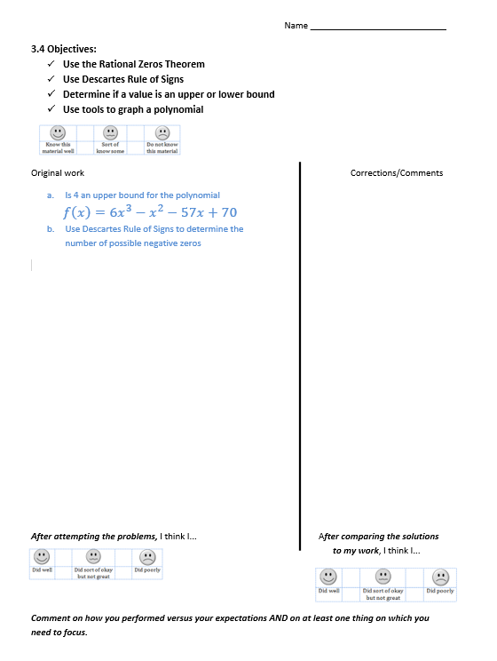
Self-Assessment (not a quiz!)
3.4 Objectives:
Use the Rational Zeros Theorem
Use Descartes Rule of Signs
Determine if a value is an upper or lower bound
Use tools to graph a polynomial
Comment on how you performed versus your expectations AND on at least one thing on which you need to focus.

Slide 11
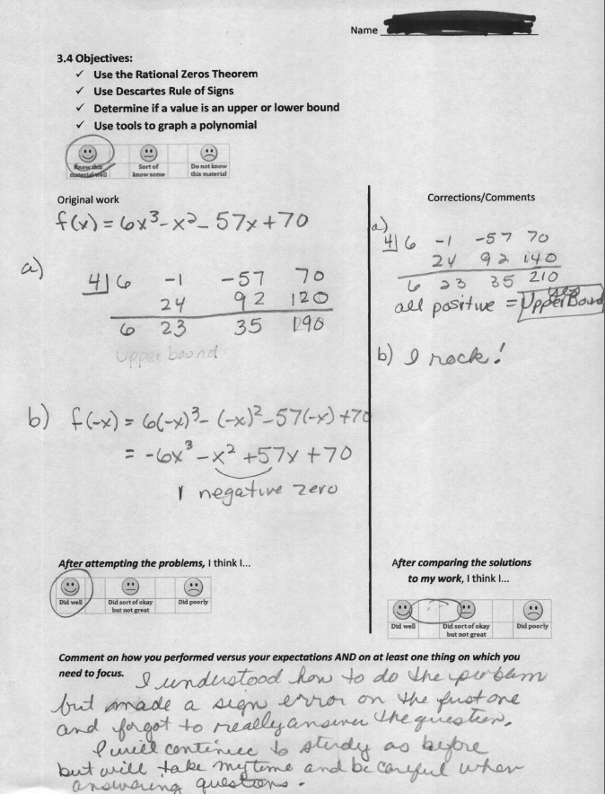
Good Example
Not about correct answers:
Made a comment about WHY it is upper bound
Corrected the arithmetic error
Self praise
Reminder to answer question
Feedback of next steps

Slide 12
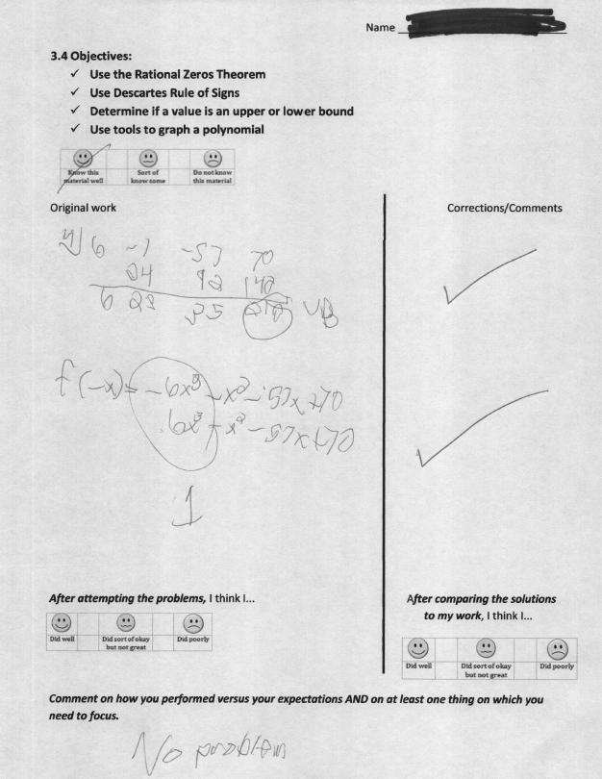
Not So Good Example
Half hearted:
Circled 210 so maybe positive remainder is why ‘UB’
Rule of sign executed wrong
Just saw the right answer so not analysis of work
No circling of ‘after’ emoticons
No reflection, no understanding of struggle.

Slide 13
More Self-Assessment

Slide 14
What is one thing you did when the pandemic hit to foster student ownership? Phrases with spaces allowed on this poll
Let’s take another quick poll:
Click on this question above to see the poll results.

Slide 15
Sometimes when we try something new, we are pleasantly surprised!
Test Corrections and Student/Faculty Ownership

Slide 16
Face to Face Test Corrections
Tests should not be ‘just’ a summative assessment. Students should review their work to learn from their mistakes.
Create student ownership of learning now and for the future.
Help students discover how to track & categorize the mistakes they make while testing.

Slide 17
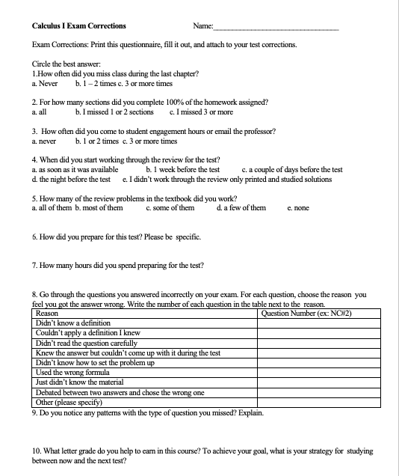
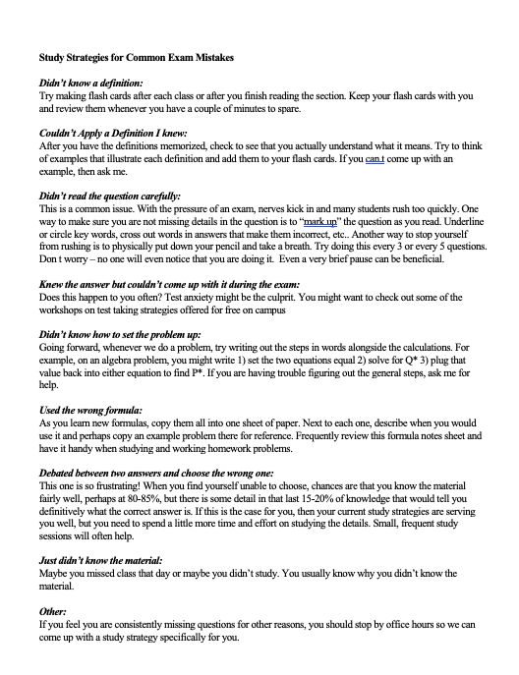
Questionnaire Example

Slide 18
Questionnaire Example

Slide 19
Questionnaire Example

Slide 20
Questionnaire Example

Slide 21
Questionnaire Example

Slide 22
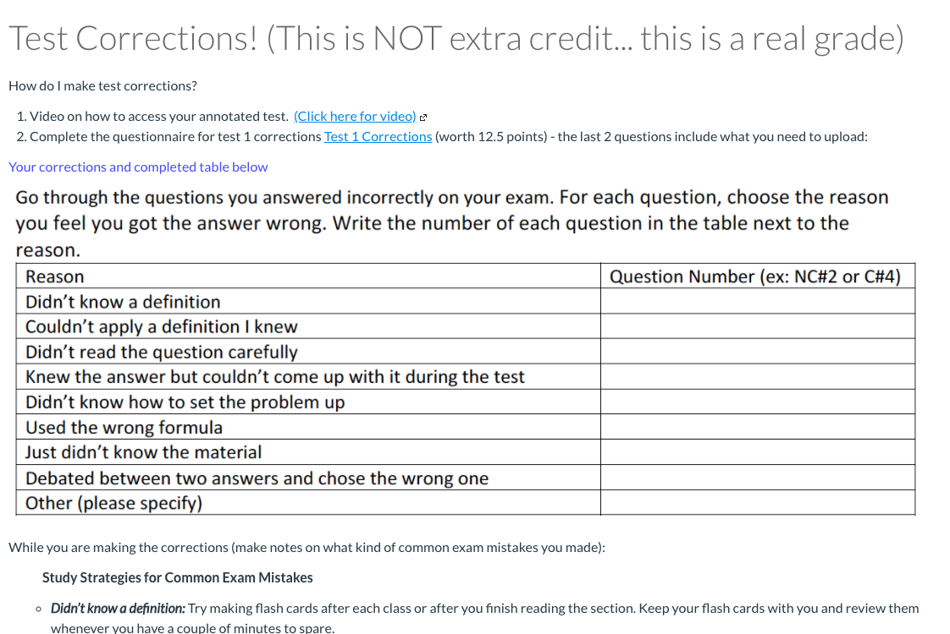
Online Module (my new preference)

Slide 23
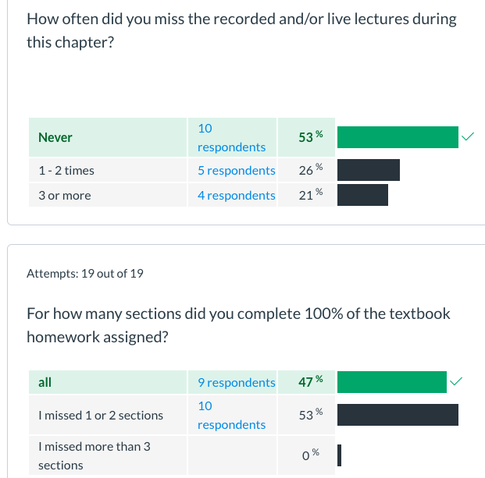
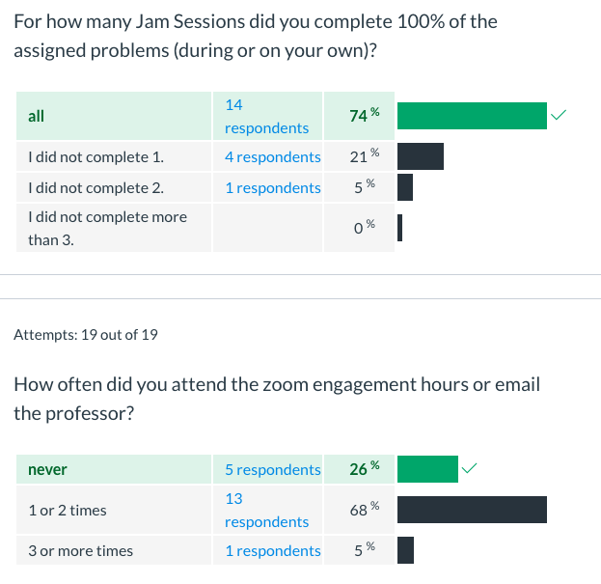
Online Module Results

Slide 24
Tests Corrections: Old vs. New
Face to Face:
Paper Copy
Questionnaire
Do Test Corrections
Attach to Test
Hand-in
Online:
Quiz features in Management System
Time tracking answers
Statistical Data can be analyzed
Upload

Slide 25
How do I do _____ in a pandemic? HashtagableAnswersOnThisPoll
Let’s take one last quick poll:
Click on this question above to see the poll results.

Slide 26
Pandemic hits...
What do I do now?
"Things work out best for those who make the best of how things work out." -John Wooden

Slide 27
Faculty Ownership
Three Key areas of faculty ownership:
Creating a learning environment
Taking an active role in course design
Becoming a reflective practitioner
(IMPACT, 2018)

Slide 28
Learning Environment
Method of Instruction
Things changed in the middle of our semester
Exams, classwork, quizzes, homework
Teamwork
We are all in this together
Structure
Diversity
Be sensitive to situational factors
Following up with students who went inactive
Learning outside the classroom
Be available outside class meetings

Slide 29
Course Design
Goal: Foster Learning
Exams
Adaptations made (ungoogle-able questions)
Learning outcomes
Remain the same
Use technology that is accessible to all students.
Effective assessment cycle:
Planning->gathering data->interpreting->implement change

Slide 30
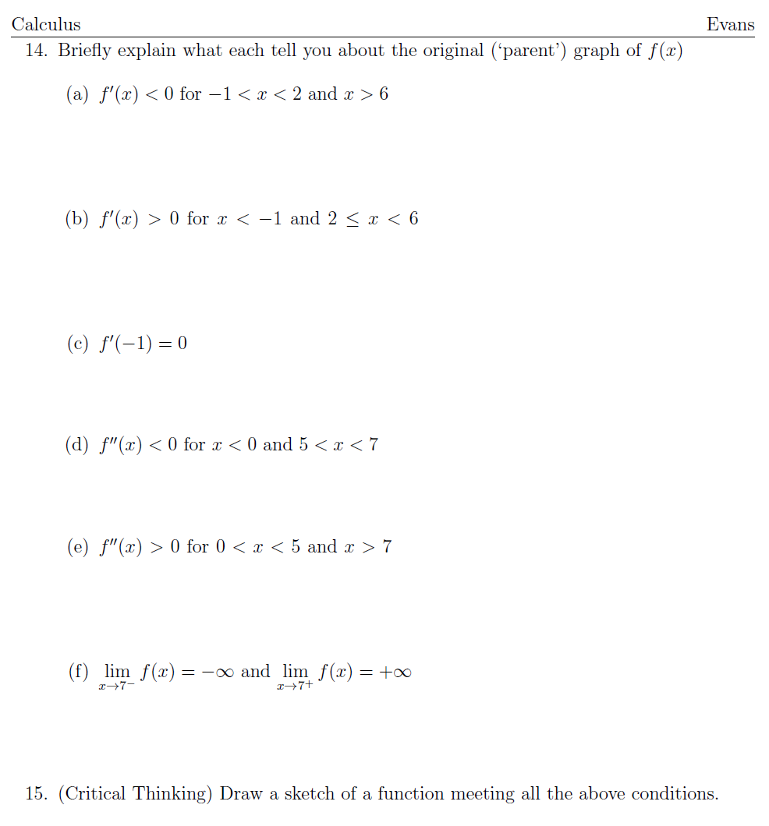
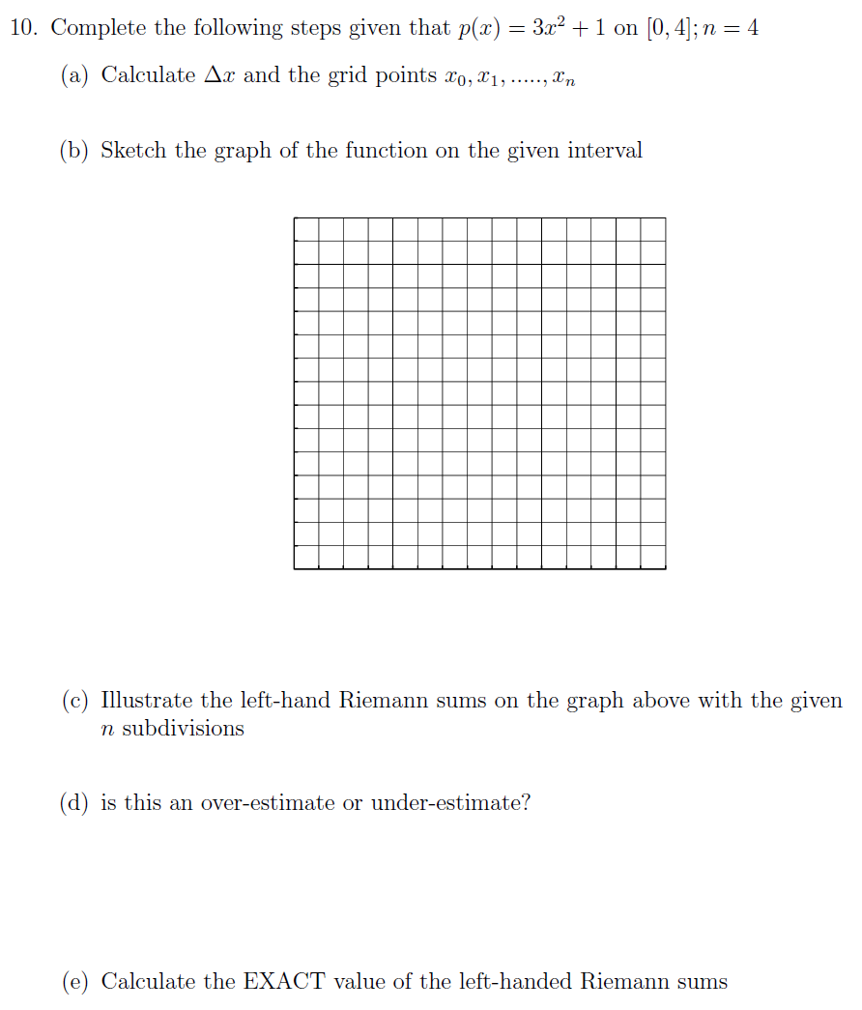

Slide 31
Reflective Practitioner
Examine curriculum and teaching practices
Keep abreast with current research on learning and teaching (MAA, AMATYC, NOSS, NCTM etc…)
Action research projects
Collaboration (MAA Connect, IMPACT Live!, NCTM Blogs, etc...)
Understand what ownership is

Slide 32
Department & Institution Ownership
Supply the necessary equipment and training
Ensure that students have access to any needed technology
Support best practices

Slide 33
What have I found in this new environment… that I will continue to do in the future?

Slide 34
Upcoming 4th National Mathematics Summit - February 23-24, 2021 - Westgate Resort and Casino - Las Vegas, NV
The 4th National Math Summit begins at 1:00 p.m. on Tuesday, February 23rd, and features keynote speaker, Jenna Carpenter, concurrent sessions, and more. The program will conclude Wednesday, February 24th at 5:00 p.m. This is a pre-conference to the NOSS 2021 conference and requires separate registration (https://thenoss.org/Math-Summit/)
The Math Summit is sponsored by AMATYC, NOSS, and Paul Nolting. Supporting partners include: Charles A. Dana Center, Carnegie Math Pathways/WestEd, and the MAA.

Slide 35
Upcoming 4th National Mathematics Summit - February 23-24, 2021 - Westgate Resort and Casino - Las Vegas, NV
Planning Leadership Team
Annette Cook, Paul Nolting, Julie Phelps and Nancy Sattler
Steering Committee
Christina Cobb and Denise Lujan (NOSS)
Rochelle Beatty, Kathryn Van Wagoner, and Laura Watkins (AMATYC)
Connie Richardson and Paula Talley (Charles A. Dana Center)
Ann Edwards (Carnegie Math Pathways/WestEd)
April Strom (MAA)

Slide 36
Upcoming 4th National Mathematics Summit - February 23-24, 2021 - Westgate Resort and Casino - Las Vegas, NV
July 21, 2 p.m. ET
Equity in the Math Classroom: Strategies for Reaching Every Student
Jenna Carpenter
Sponsored by AMATYC Equity Committee and NOSS Equity, Access and Inclusion
August 19, 2 p.m. ET
Implementation of the Common Vision through the Eyes of the Teaching Practitioner
Nancy Sattler, Denise Lujan,Annette Cook and Julie Phelps
Sponsored by AMATYC Standards Committee and NOSS
September: Developmental Math Partnership
October: Pathways Partnership
November: Professional Development & Department Issues in a Pandemic
January: Student Engagement

Slide 37
Thank you for participating in this Webinar.
Let’s spread the word about Ownership
Come join us on my.amatyc.org to continue this conversation on IMPACT Live!
Look us up in the directory! See you there.

Slide 38
Contact Info Karen Gaines – karengainesedu@gmail.com Julie Phelps – jphelps@valenciacollege.edu Evan Evans – eevans@frederick.edu

